Slide 1
Court OF JUSTICE
Organization name: Dr.B.R.Ambedkar Institute of technology
Problem statement: Court case management software
Team name: Tech buddies
Team leader name: S.R.Bindu Sri
College code: 1-3513518529

Slide 2
IDEA/SOLUTION/PROTOTYPE
Problem faced: Lack of information about methodologies for managing the life cycle of a case or legal issues
Basic intention: To provide end to end management of court case from client perspective
Functions: Records the information like adding case, facility to add lawyers,
add invoice for each hearing
Additional functions: User can provide feedback, give rating to lawyer
Works on: Any smart phone or desktop(computer), with internet connectivity
TECHNOLOGY STACK
Languages: HTML,PHP Database: Oracle 10g Operating system: Windows
Hardware requirements: PC,Laptop
Software requirements: 1.Adobe Dreamweaver, 2.Notepad++ editor
Front-end development tools: UI design tools, Adobe illustrator

Slide 3
Use case diagram client point of view

Slide 4
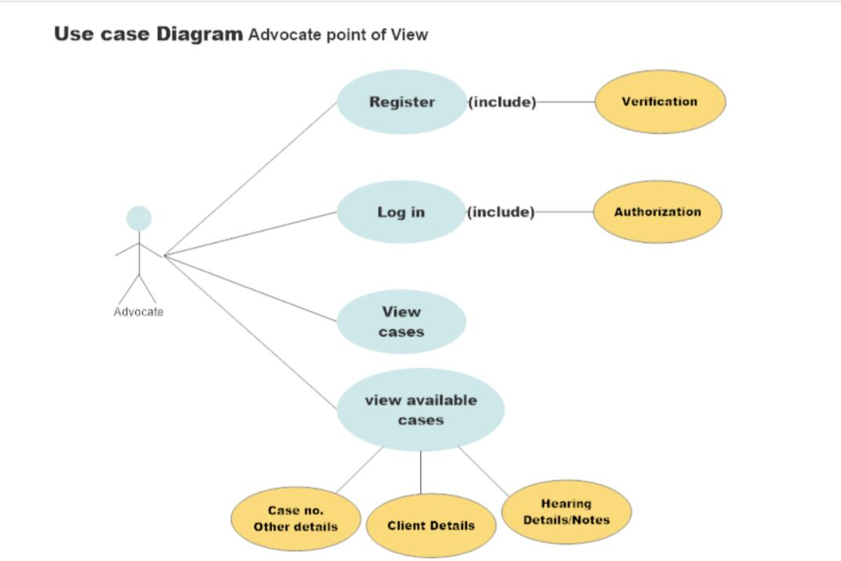

Slide 5
Show Stopper
The features of the website is a direct answer to finding lawyers for all kinds of cases. Our ENROLLMENT feature allows the client and lawyers to enroll their cases and information respectively.
Our SEARCH feature enables giving relevant results to the user according to their requirements and the domain the case belongs to,so .
Dependencies
Lawyers and their information
FIR data
For authentication: Aadhar/passport/driving license and pan card data to be verified
Court cases
Official Government Firewall

